Slide 1

Online Shopping Management System
Team:Class 1 Group1
PM:YangXue

Slide 2
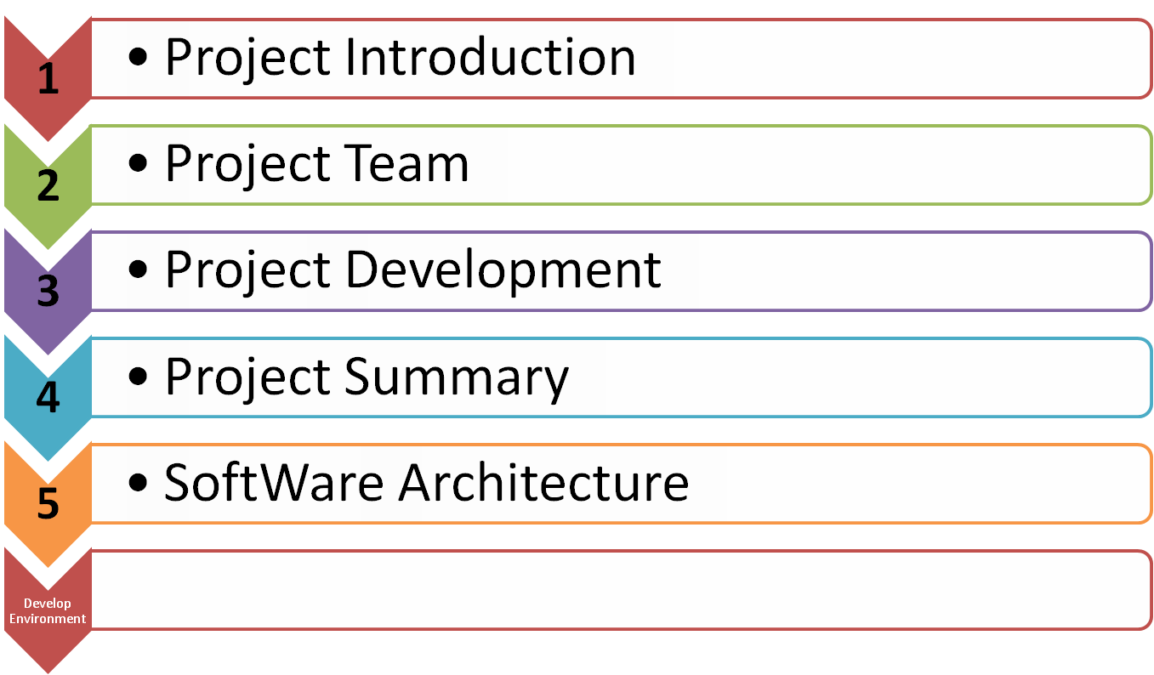
Contents

Slide 3
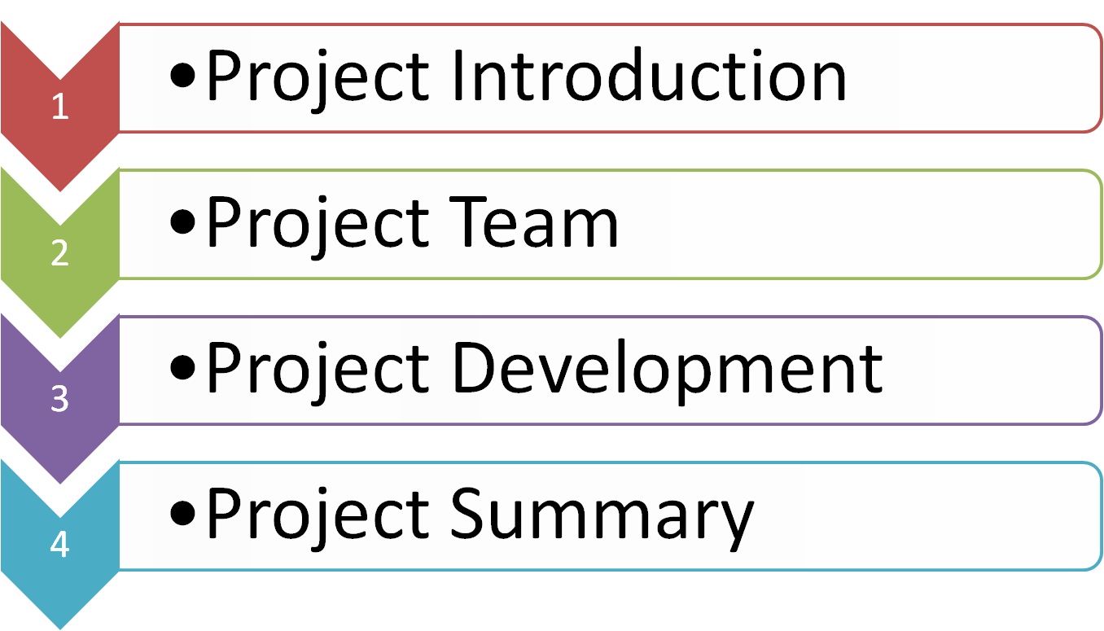
Contents

Slide 4
Project Introduction
Name:
Online Shopping Management(TianGou)
Topic:
Shopping management, php, B/S, online

Slide 5
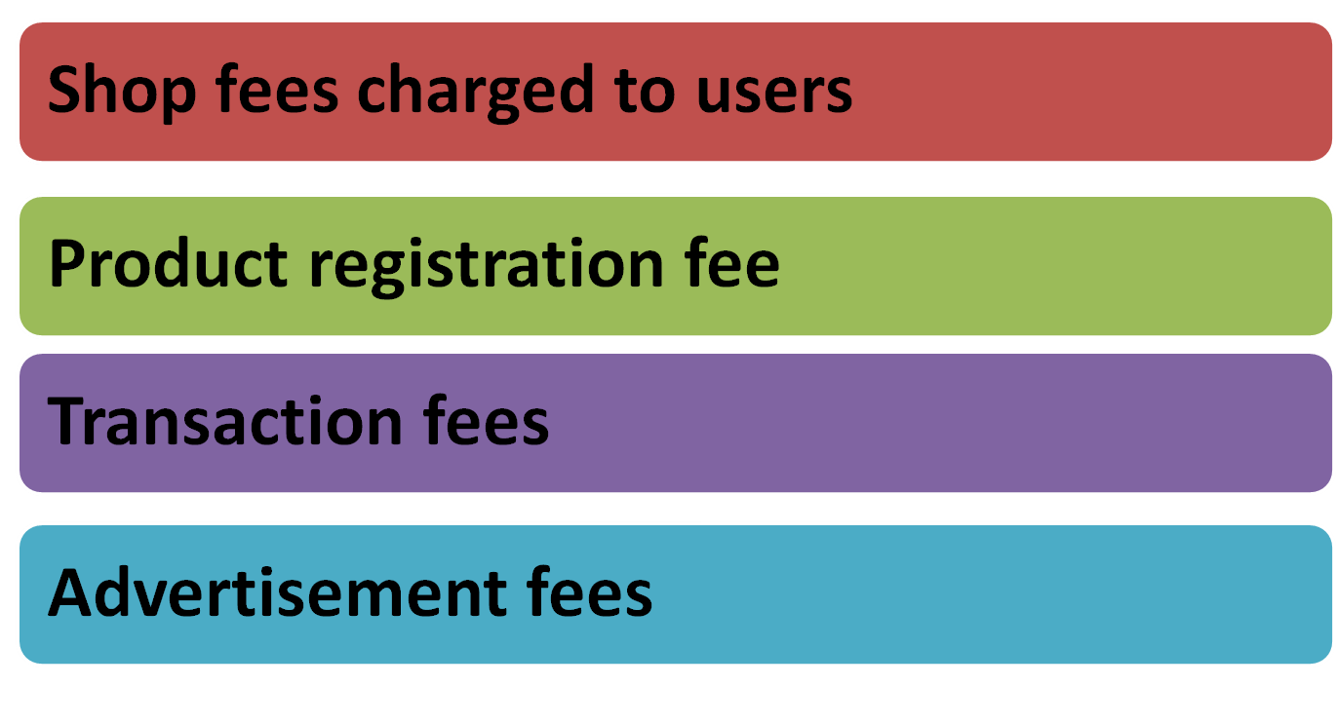
Project Aims

Slide 6
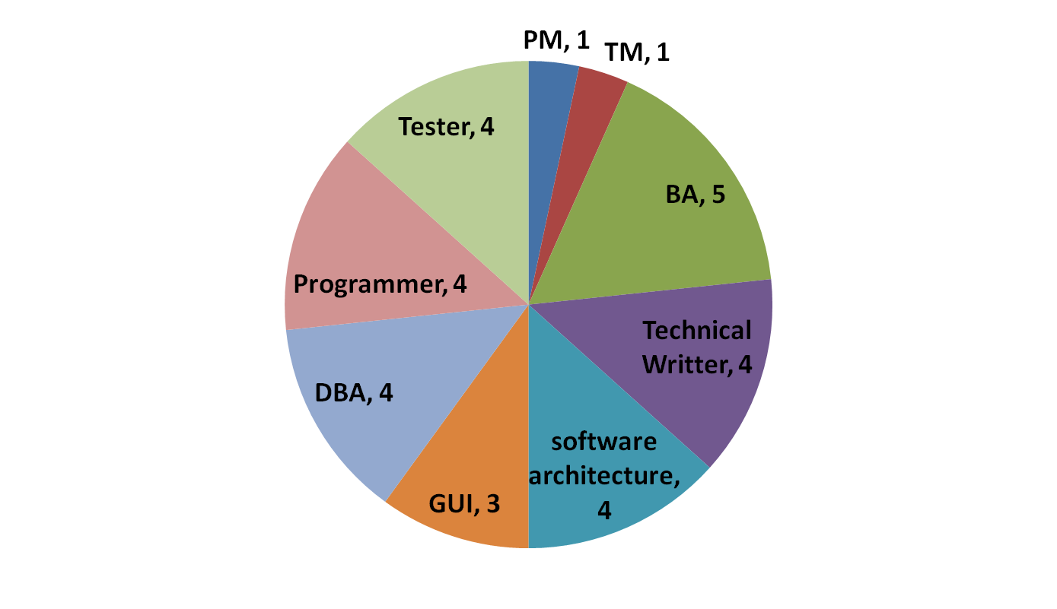
Team Structure
Our group is made up of 30 students

Slide 7
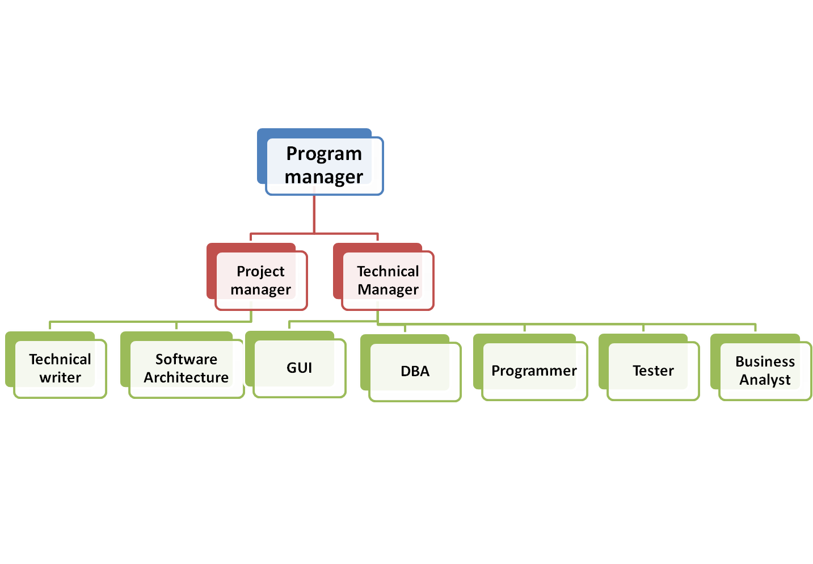
Team Organization

Slide 8
Team Duties
Project manager:
Manage the schedule and proceeding of the project and coordinate the communication of each team.
Technical manager:
Provide technical support to the team which has problems with developing the project, with the focus on the proceeding of the project.

Slide 9
Team Duties
Business analysis:
Based on the survey and the QA,bring forward the requirement and write the requirement down in the SRS document,analysis the business risk for the project.
Software architect:
Base on the requirement brought forward by BA team,design the software we will write would be look,and design the architecture of the program

Slide 10
GUI design:
Based on the BA team ,design the GUI Prototypes and provide the GUI to the Developer team.
Programmer:
Based on the SA team ,the BA team ,the GUI team and the DBA team, coding the program, and accept the bugger from the Test team, and then rebuild the project.
DBA:
Design the database for the developer team.

Slide 11
Tester:
Based on the requirement, design the teat case for the program, after the Developer team submit them work, test the program by black-box test and white-box test, and give back the result of test to Developer team ,and then write the test case and the result down to the document
Technical writer:
Based on the program, write the notice of the program and how to maintain the program to user.

Slide 12
Team rules
1.PM and TM are the general principal for our project and control the whole schedule and other things related.PM take responsibility for the coordination between teams,while TM is responsible for the technical problems. And in some degree,TM receives commands from PM.
2. Team leaders is responsible for specific team,who assign tasks to team members and do some work together.
3. Every team member finish their tasks efficiently and carefully.If there is any objection ,team member should reflect problem to the team leader,and solve it after coordination.

Slide 13
Work rule
1. All group members are supposed to finish their tasks on time, and do it as careful as possible .
2. Every group member should have teamwork, and don’t be self-centered any time.
3. Make sure that you keep touch with the group any time with QQ or phone.

Slide 14
Platform&Standard
OS: windows 7 Ultimate
Programming Language: javacript,html5,
php Version 5.3.10-1
Develop Tools: photoshop CS5,mysql 5.5, sublime text2 version 2.2 ,apache
Server App: apache
Database: mysql 5.5
Test Tools: Chrome

Slide 15
Scope
Three Kinds of Users:
Guest, User, Administrator
Three Mainly kinds of Functions:
Guest Function : Browse, Search,Regist
User Function: Login, Buy, Shopping cart management…
Administrator Function :Add goods…

Slide 16
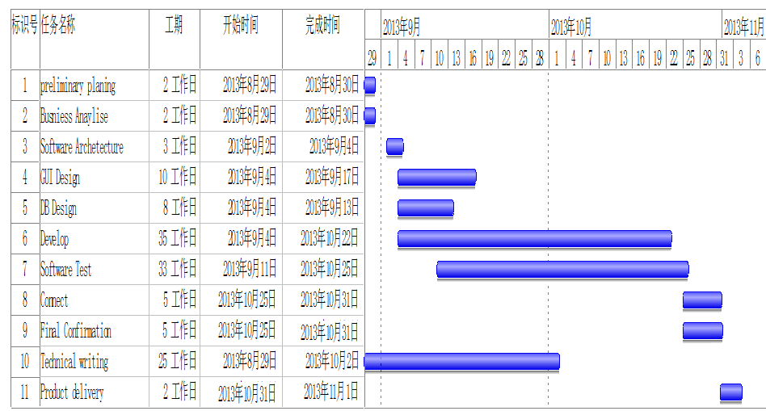
Project Schedule

Slide 17
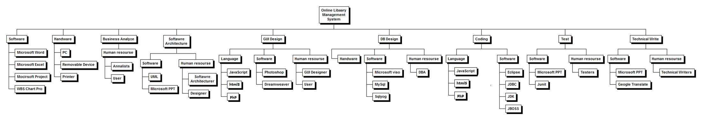
Resource & Communication

Slide 18
Cost&Risk
列1 | 列2 | 列3 | 列4 | 列5 | 列6
 | #Units/h | Cost/Unit/h | Subtotals | WBS Level 1 total | % of total
WBS Items
1.Project Management |  |  |  | ¥551,200 | 65.91%
1.1 PM | 500 | ¥100 | ¥50,000
1.2 Team Member | 5,012 | ¥100 | ¥501,200
2.Hardware |  |  | ¥6,000 | ¥6,000 | 0.71%
3.Software |  |  |  | ¥150,750 | 18.02%
3.1Licensed software |  |  | ¥750
3.2Software development* |  |  | ¥150,000
4.Testing(%10 of software and hardware cost) |  |  | ¥17,850 | ¥17,850 | 2.13%
5.Training and support |  |  |  | ¥10,000 | 1.20%
5.1Trainee cost | 60 | ¥150 | ¥9,000
5.2Project team cost |  |  | ¥1,000
6.Reserves(20% of total estimate) |  |  | ¥100,560 | ¥100,560 | 12.02%
7. Total project cost |  |  |  | ¥836,360 | 100%

Slide 19
Success Criteria
 | Function Name | Class | Priority {High,Low ,Optional} | Status
1 | Register | Guest | High | Completed
2 | Login | User | High | Completed
3 | Searching commodities | Guest | High | Completed
4 | Product recommendation | Administrator | High | Uncompleted
5 | Browsing product | User | High | Completed
6 | Buying product | User | High | Completed
7 | Adding to cart | User | High | uncompleted
8 | Collecting product | User | Low | uncompleted
9 | Modifying personal information | User | High | Completed
10 | Adding shipping address | User | High | Completed

Slide 20
Success Criteria
 | Function Name | Class | Priority {High,Low ,Optional} | Status
11 | Viewing cart | User | High | Uncompleted
12 | Confirming receipt | User | High | Completed
13 | Adding product | Administrator | High | Uncompleted
14 | Deleting product | Administrator | High | Uncompleted
15 | Modifying order status | Administrator | High | Uncompleted
16 | Managing user personal information | Administrator | High | Uncompleted
17 | Maintaining | Administrator | High | Uncompleted
18 | Showing category list | Administrator | Low | Uncompleted
19 | Showing hot product | Administrator | Low | Uncompleted
20 | Linking to other websites | Administrator | Low | Uncompleted

Slide 21


The end

